Slide 1


Irradiance estimation from sky images for PV power prediction
Amrollah Seifoddini
Supervisors:
Prof. Marc Pollefeys Dr. Jan Poland
March 2016

Slide 2
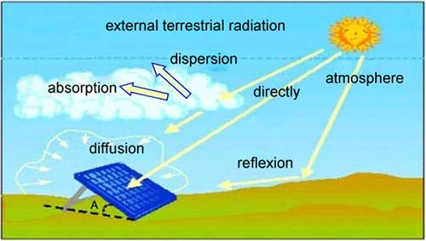
Motivation & goal
Sky imager based shortest-term solar irradiance forecasts for local solar energy applications

Slide 3
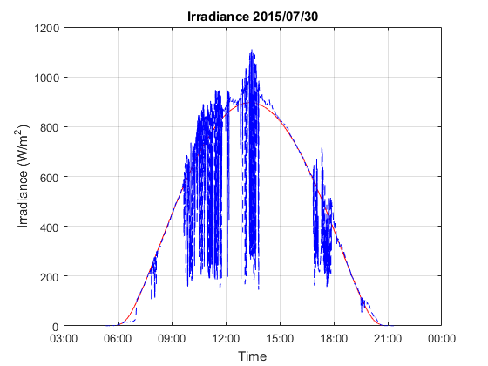
Effects of clouds
Up to 85% irradiance drop
Up to 20% irradiance enhancement

Slide 4
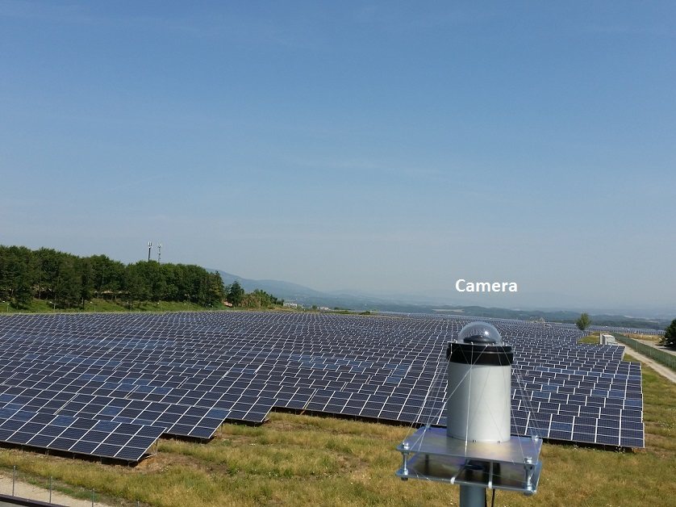
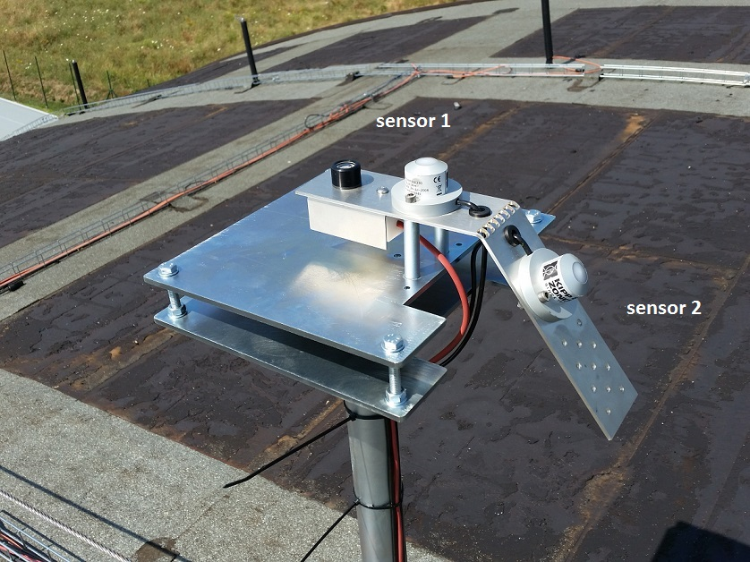
Experimental setup (in Cavriglia)

Slide 5
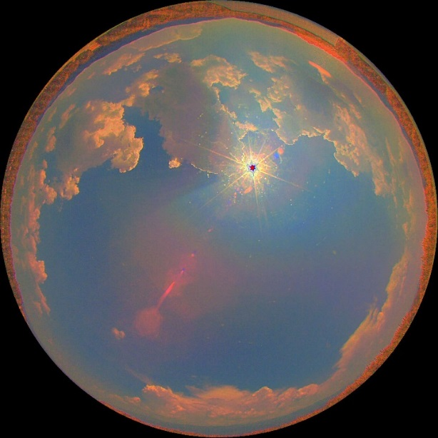
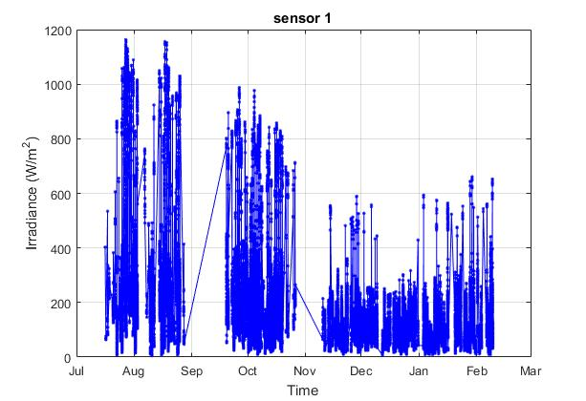
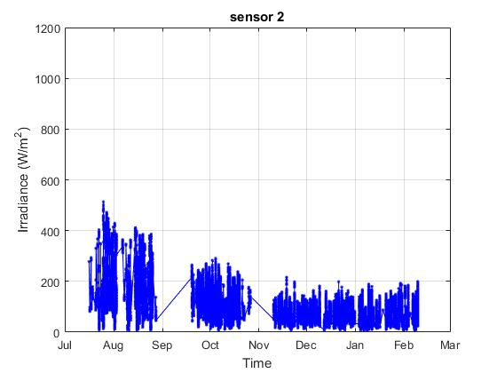
Acquired Data
HDR Images and Irradiance every 8 seconds
Power every 3 seconds

Slide 6
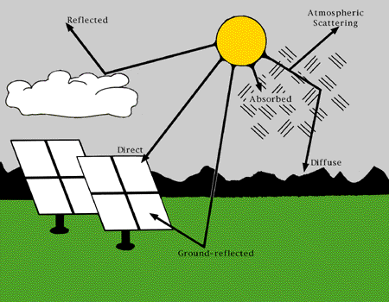
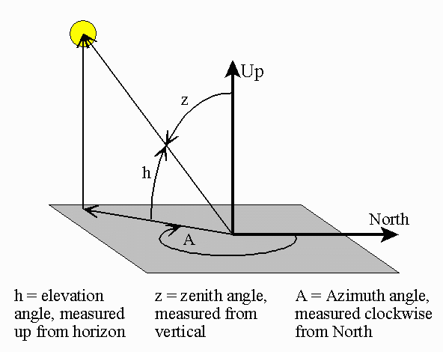

Irradiation components
Global Horizontal Irradiance (GHI)
Diffuse Horizontal Irradiance (DHI)
Direct Normal Irradiance (DNI)
$GHI=DNI ×\cos{(Z)}$ + DHI + reflected

Slide 7
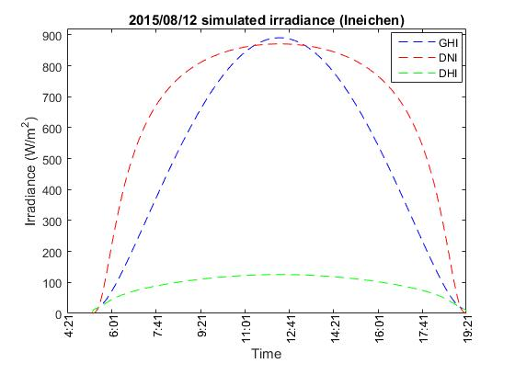
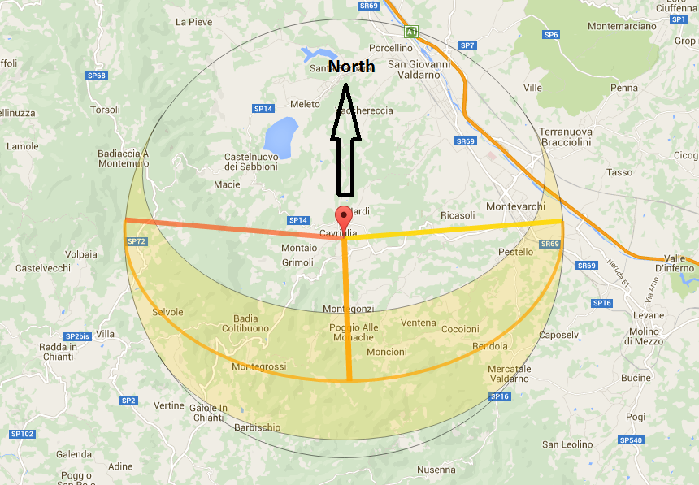
Irradiation components (cont.)

Slide 8
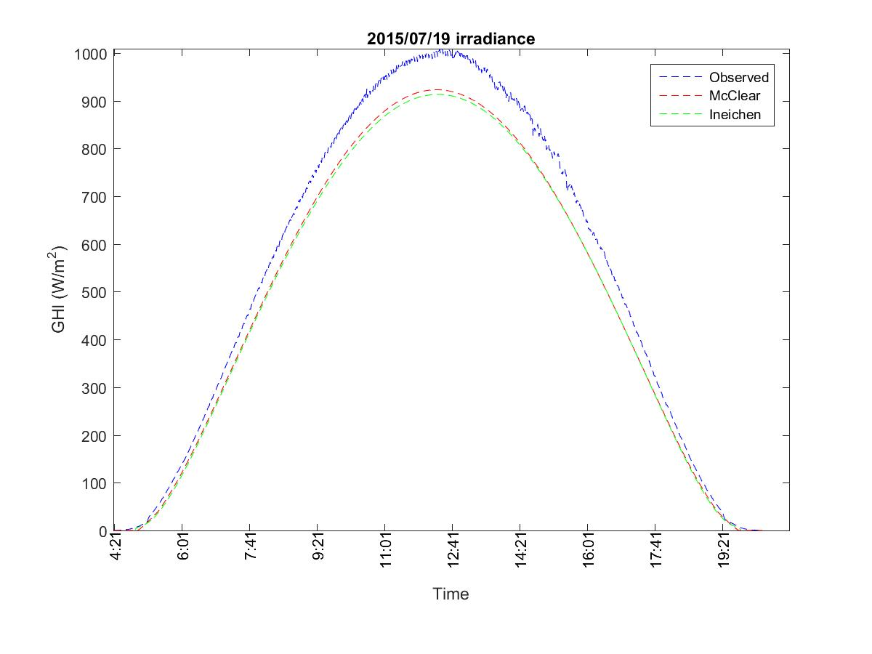
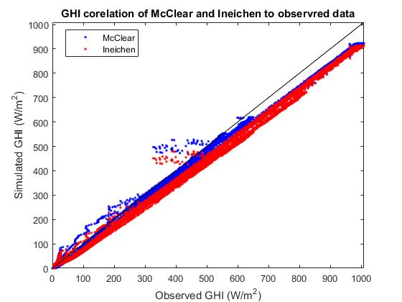
Clear-sky irradiance model

Slide 9
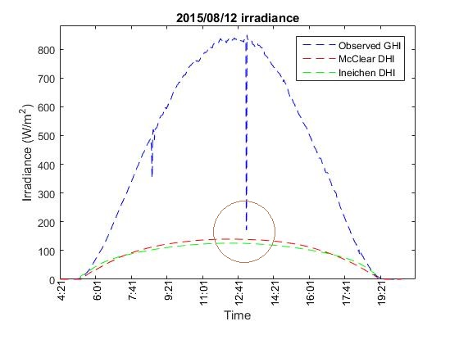
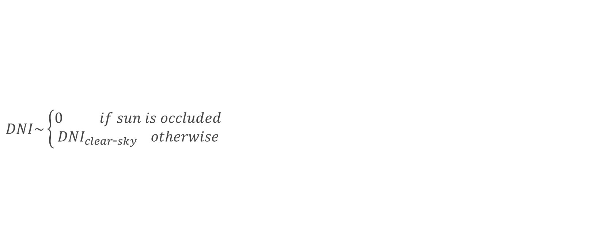
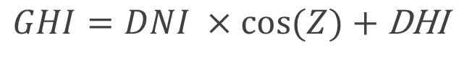
Estimating DNI (from clear-sky model)
$DNI\sim \left\{\begin{aligned}0 if sun is occluded \\ {DNI}_{clear\text{-}sky} otherwise\end{aligned}\right.$
0
$$GHI=DNI ×\cos{(Z) \text{+} \text{DHI}}$$

Slide 10
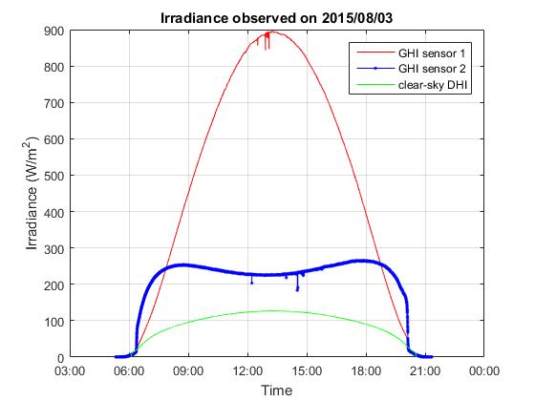
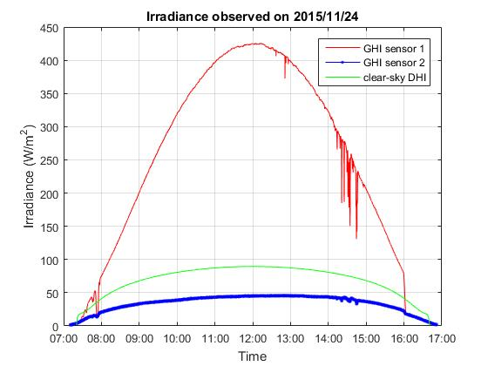
Estimating diffuse from sensors
Notes:
Using clear_sun_flag and estimated DNI for calculating diffuse from tilted plate
We only consider images with complete visible sun or no sun at all.
Extracted diffuse from north-facing plate is more robust than south-facing one

Slide 11
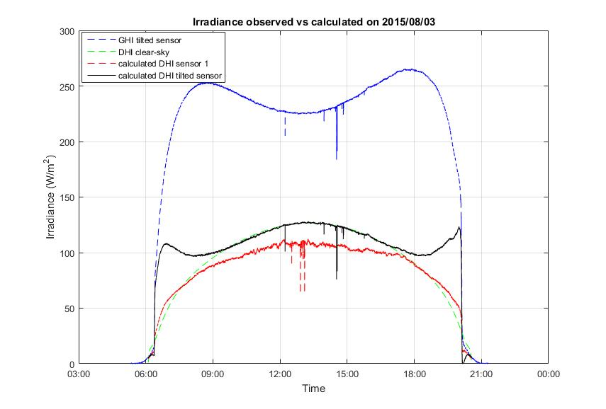
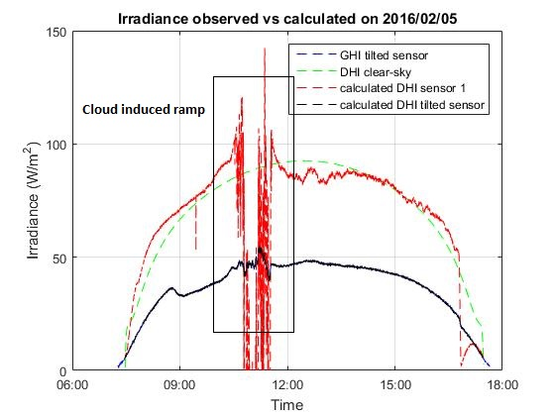
Estimating diffuse from sensors (cont.)
$$θ=Arctan2(\left\|a ⊗ b\right\|, a∙b)$$
Notes:
Using clear_sun_flag and estimated DNI for calculating diffuse from tilted plate
We only consider images with complete visible sun or no sun at all.
Extracted diffuse from north-facing plate is more robust than south-facing one

Slide 12
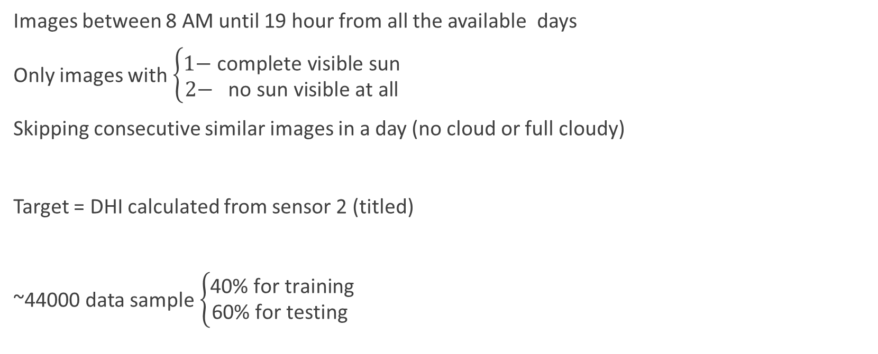
dataset
Images between 8 AM until 19 hour from all the available days
Only images with $\left\{\begin{aligned}\text{1− }\text{complete} \text{visible} \text{sun} \\ 2\text{− }\text{no} \text{sun} \text{visible} \text{at} \text{all}\end{aligned}\right.$
Skipping consecutive similar images in a day (no cloud or full cloudy)
Target = DHI calculated from sensor 2 (titled)
~44000 data sample $\left\{\begin{aligned}\text{40\% }\text{for} \text{training} \\ \text{60\% }\text{for} \text{testing} \end{aligned}\right.$

Slide 13
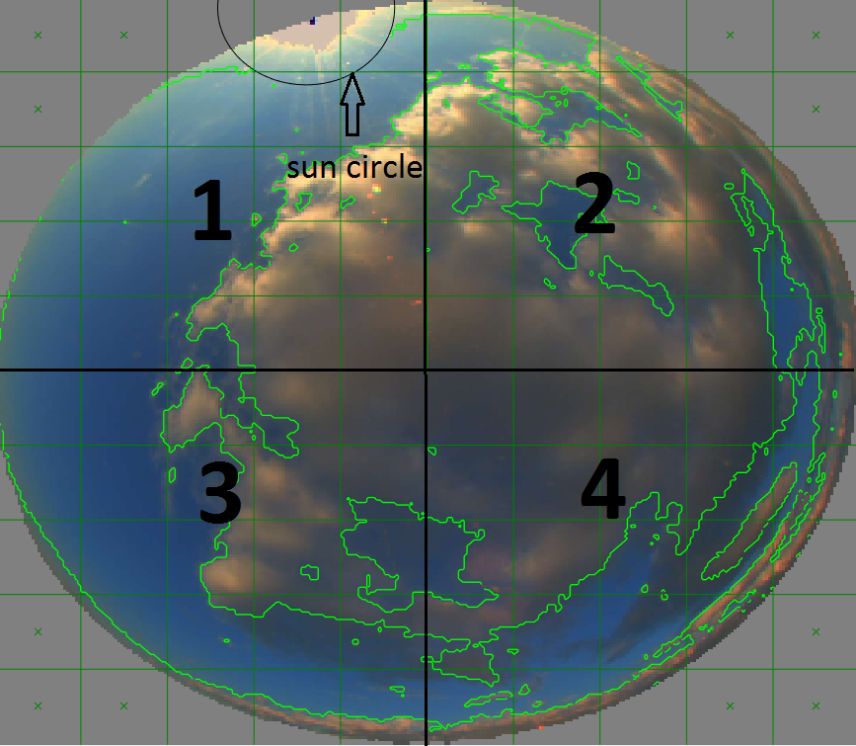
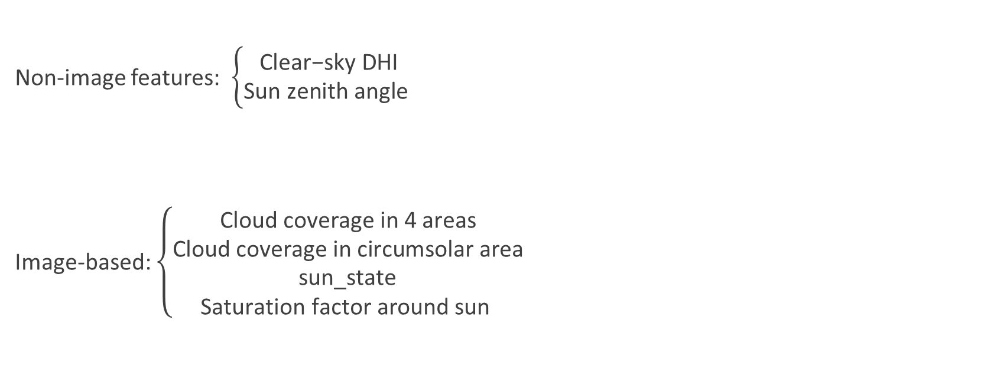
Estimating diffuse from Image features
Non-image features: $\left\{\begin{aligned}\text{Clear}\text{−}\text{sky} \text{DHI} \\ \text{Sun} \text{zenith} \text{angle} \end{aligned}\right.$
Image-based: $\left\{\begin{aligned}\text{Cloud} \text{coverage} \text{in}\text{ 4 }\text{areas} \\ \text{Cloud} \text{coverage} \text{in} \text{circumsolar} \text{area} \\ \text{sun}\text{_}\text{state} \\ \text{Saturation} \text{factor} \text{around} \text{sun} \end{aligned}\right.$

Slide 14
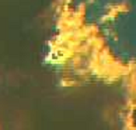
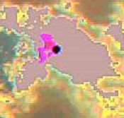
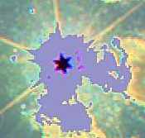
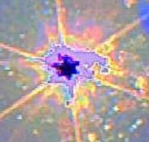
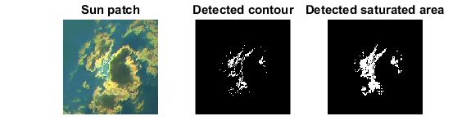
Features (cont.)
sun_state =
1
2
3
4
Saturation factor

Slide 15
Learning algorithms
K-nearest-neighbor regression
K=10
Support Vector Machine regression
RBF kernel
parameters cross-validated
Linear regression
With feature interactions

Slide 16
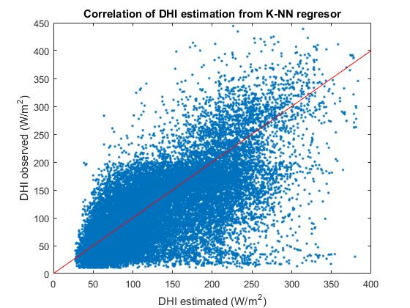
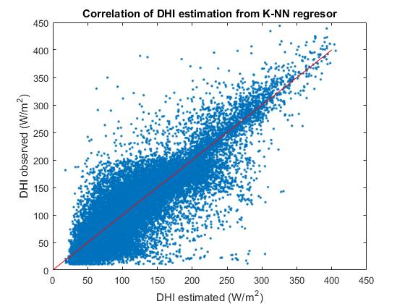
K-NN regression result
Non-image features:
RMSE = 57.2 W/m^2
All the features:
RMSE = 34.8 W/m^2

Slide 17
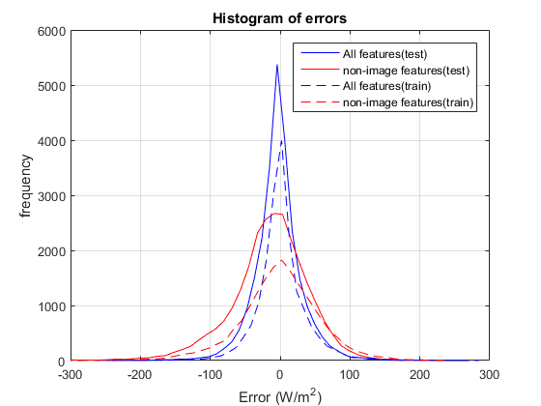
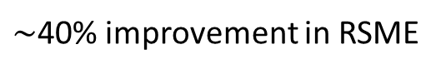
Errors
 | K-NN | Linear Regression | SVR
RMSE (no image) | 57.2 | 60.7 | 62.7
RMSE (with image) | 34.8 | 44.7 | 38.0
$\sim$40% improvement in RSME
K-NN error histogram

Slide 18
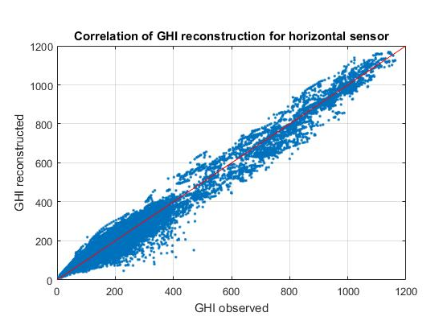
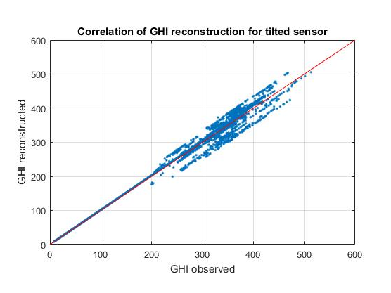

Constructing GHI
$$GHI=DNI ×\cos{(Z) \text{+} \text{DHI}}$$

Slide 19
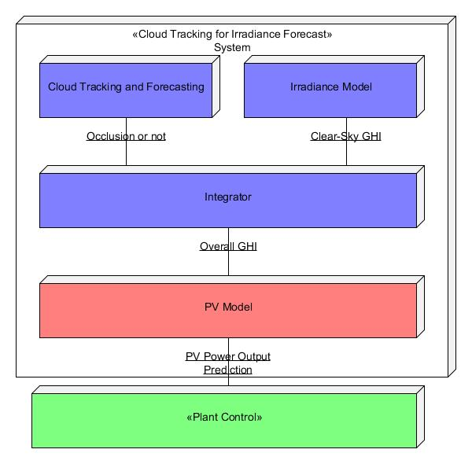
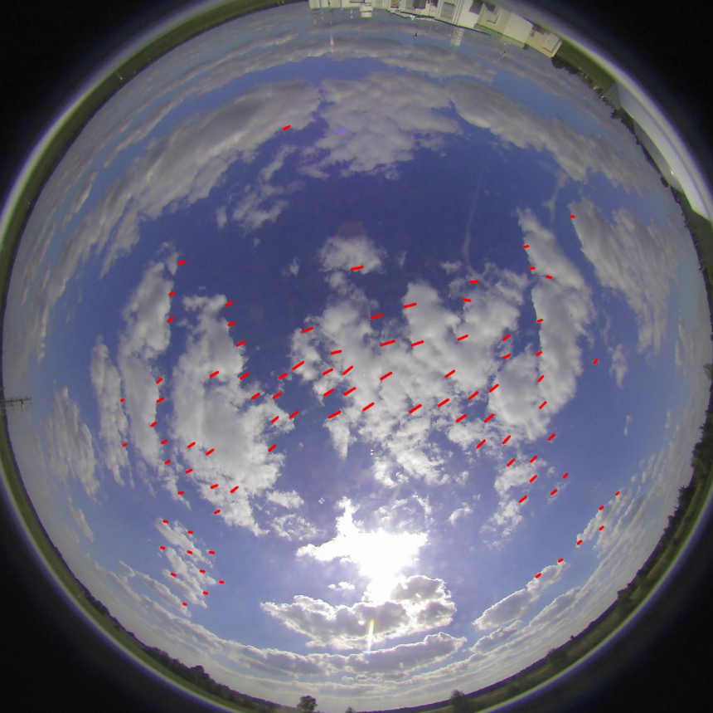
Application in irradiance forecast
Notes:
Using optical flow to extract clouds’ motion vector
Move the clouds with same motion vector

Slide 20
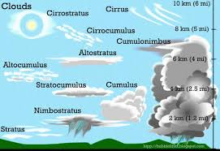
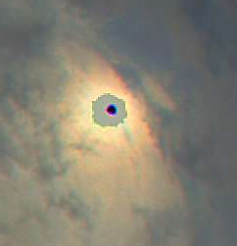
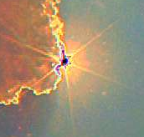
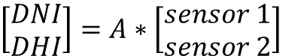
Future work
Consider partial sun occlusion
Cloud type classification
$\left[\begin{aligned}DNI \\ DHI\end{aligned}\right]=A∗\left[\begin{aligned}sensor 1 \\ sensor 2\end{aligned}\right]$

Slide 21
Conclusion
Goal: estimate diffuse irradiance from sky images
Extracting cloud state features from images
Using machine learning on image and non-image features
Improved RMSE by 40% (35 W/m^2)

